Slide 1
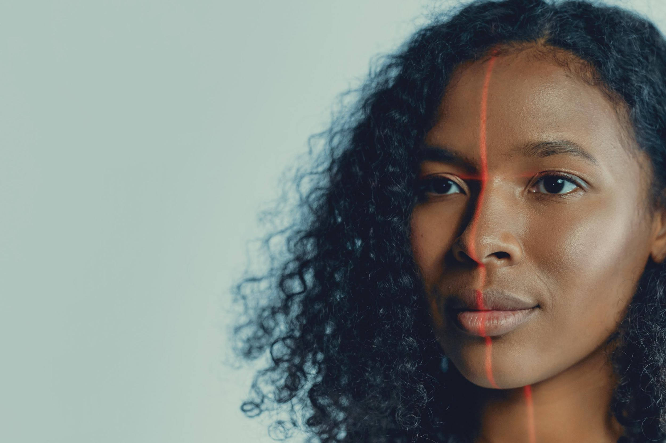
Biometric Authentication in Everyday Apps
“Enhancing Security Through Fingerprints, Face, and Voice Recognition”
Presented by: Man Lakhani
Date: 07-oct-2025

Slide 2
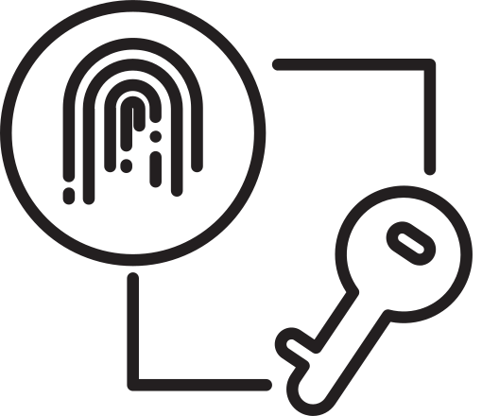
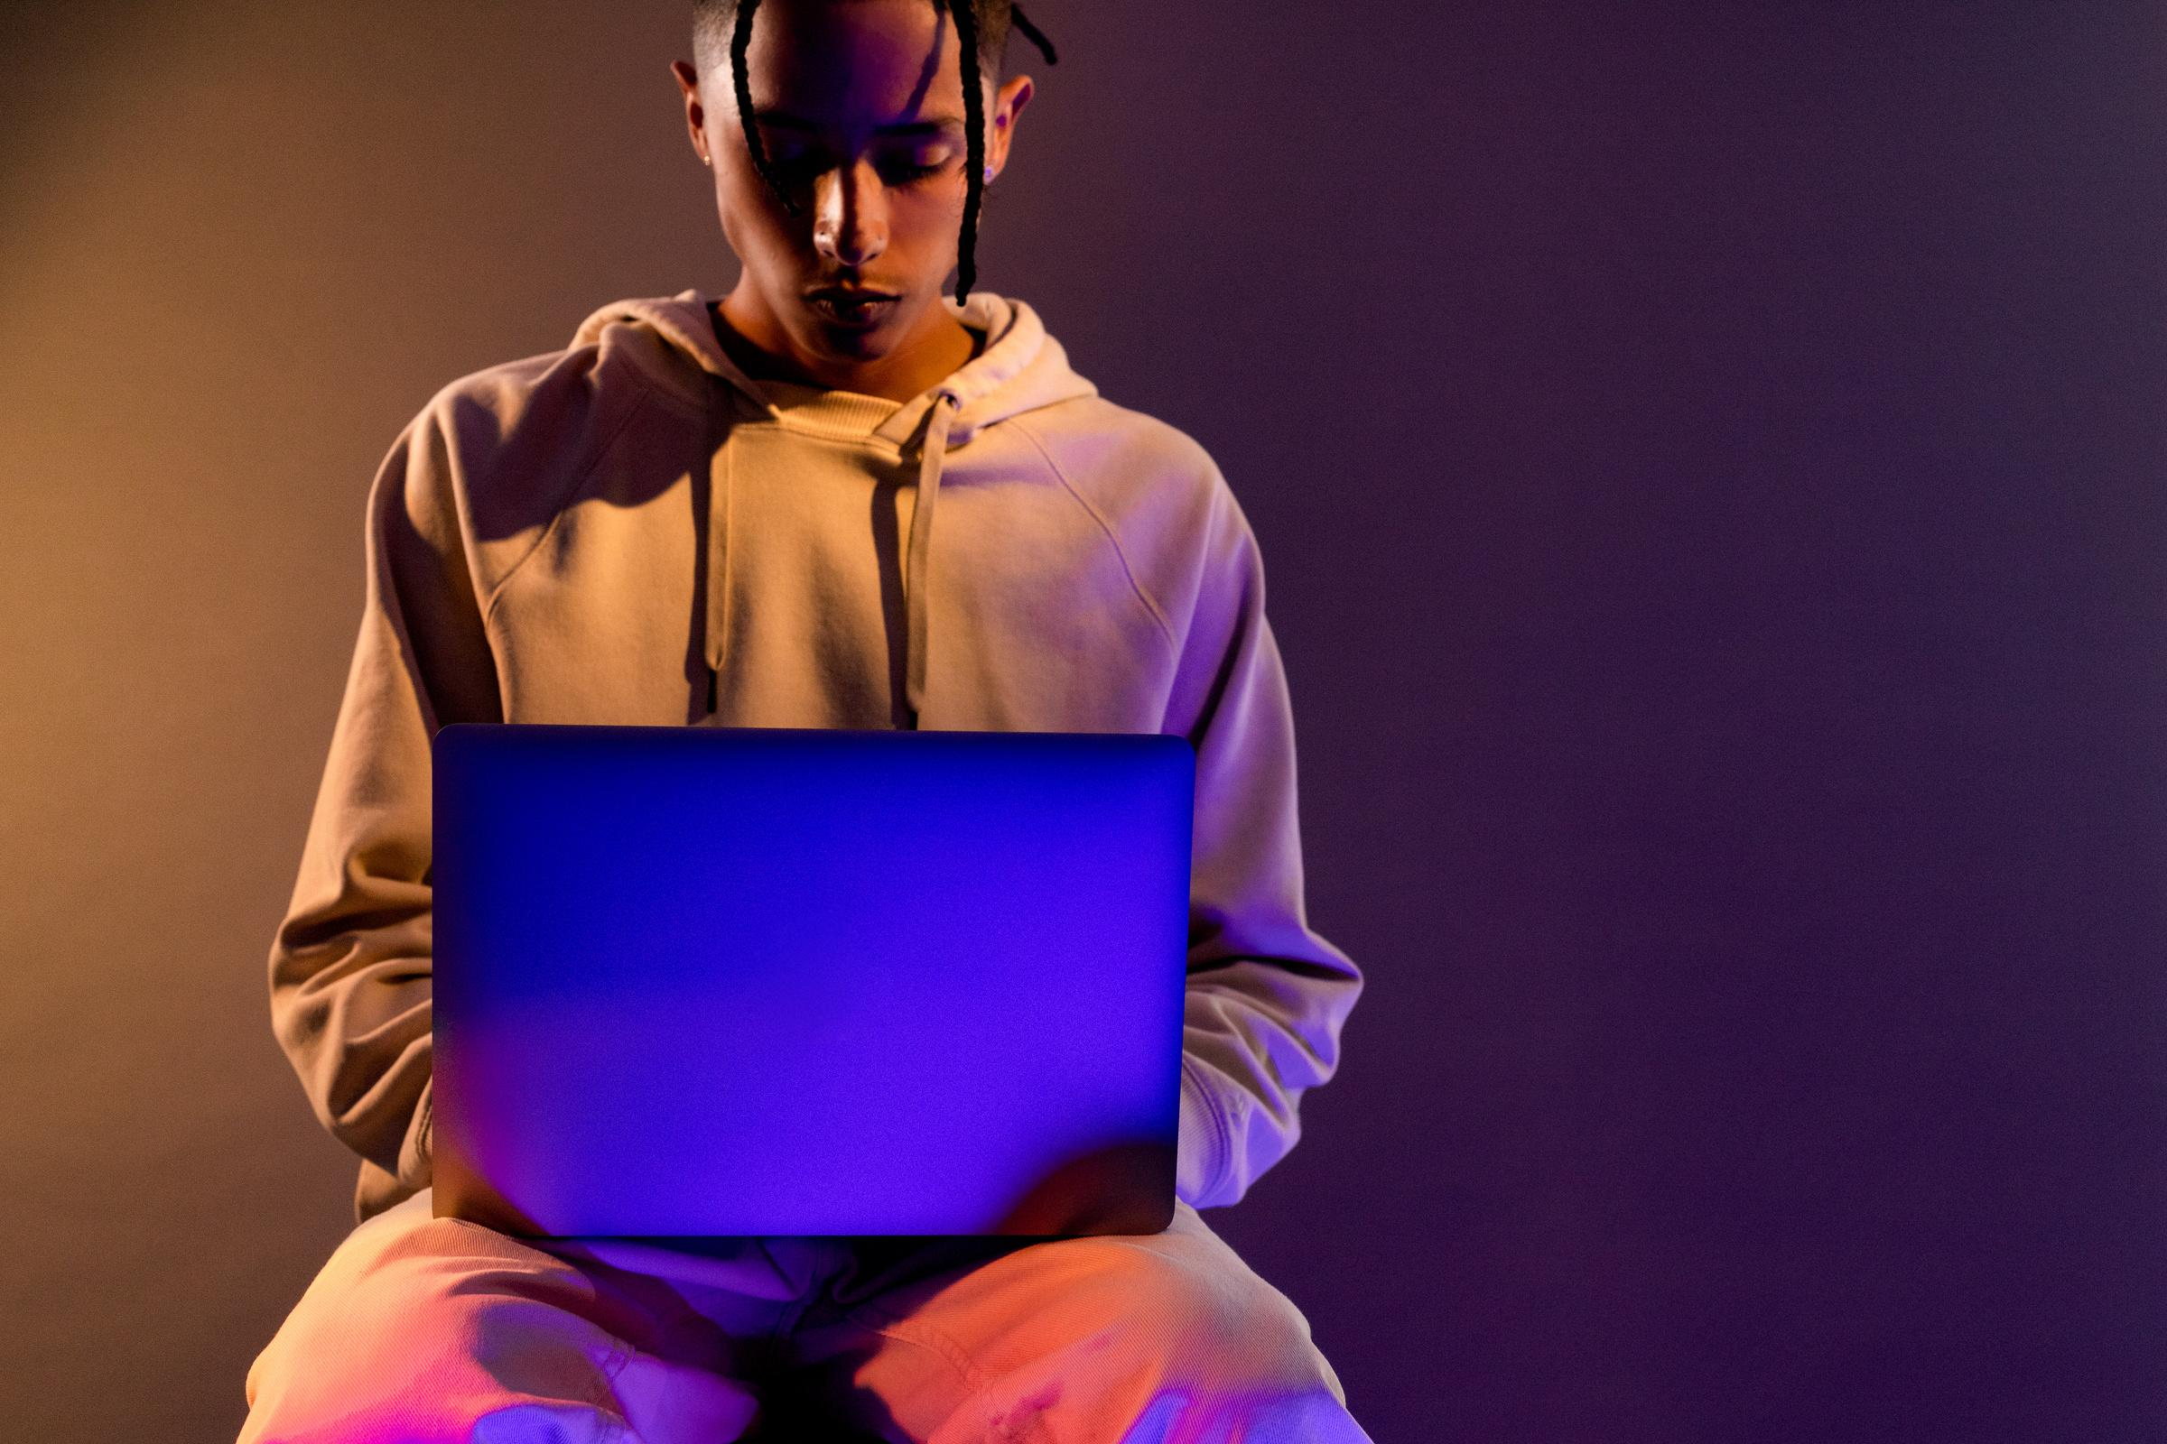
What is Biometric Authentication?
Definition: Verifying a user's identity using their unique biological or behavioral characteristics.
How It's Different:
Passwords: "Something you know" (can be forgotten, stolen).
Biometrics: "Something you are" (inherently unique, difficult to duplicate).
Examples:
→ Unlocking smartphones
→ Logging into banking apps
→ Authorizing digital payments

Slide 3


Why Biometrics ?
WHY ? : Traditional passwords are easy to forget or hack.
Biometrics offer
High accuracy
Fast user verification
Personalized experience
Security + Convenience = Better User Experience

Slide 4

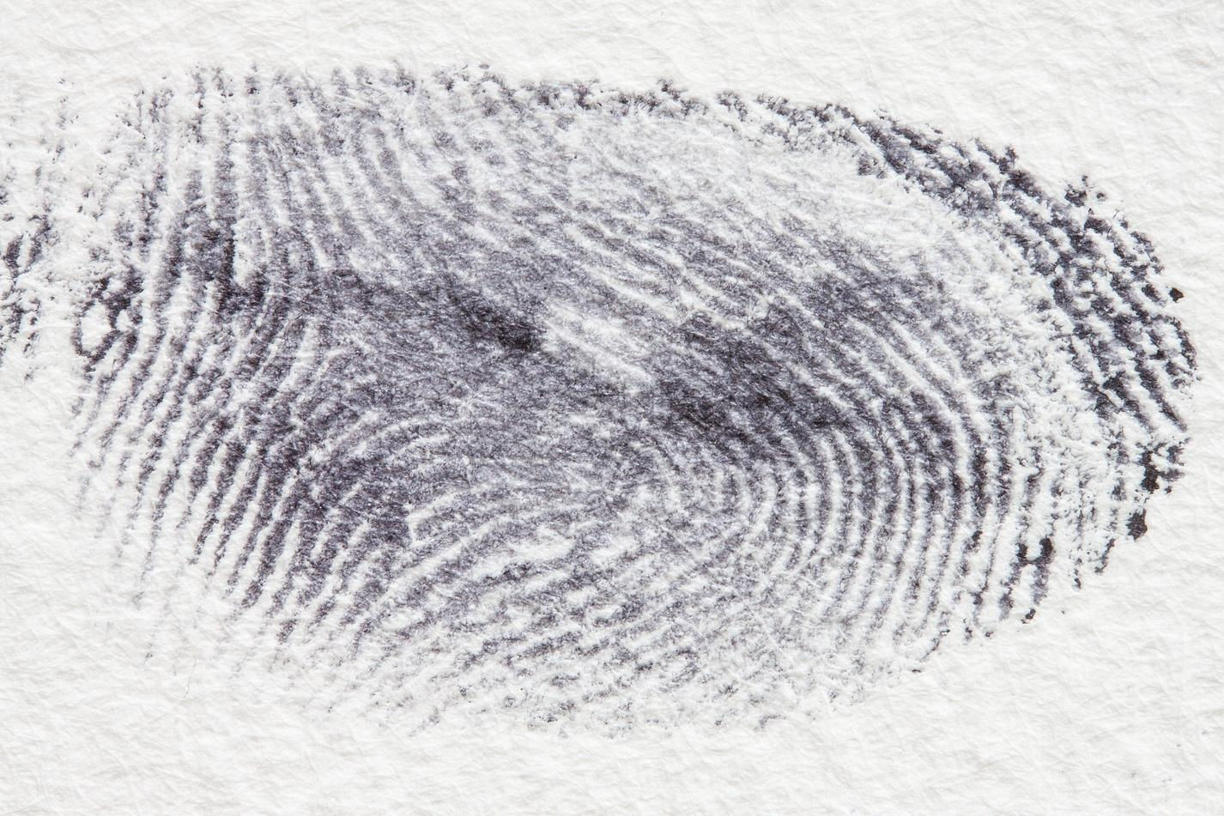
Types of Biometric Authentication
Fingerprint Recognition – Most common in mobile devices.
Facial Recognition – Used in smartphones, security systems, and social media.
Behavioral Biometrics – unique patterns in human activities for identification
Voice Recognition – Used in voice assistants and customer service.

Slide 5
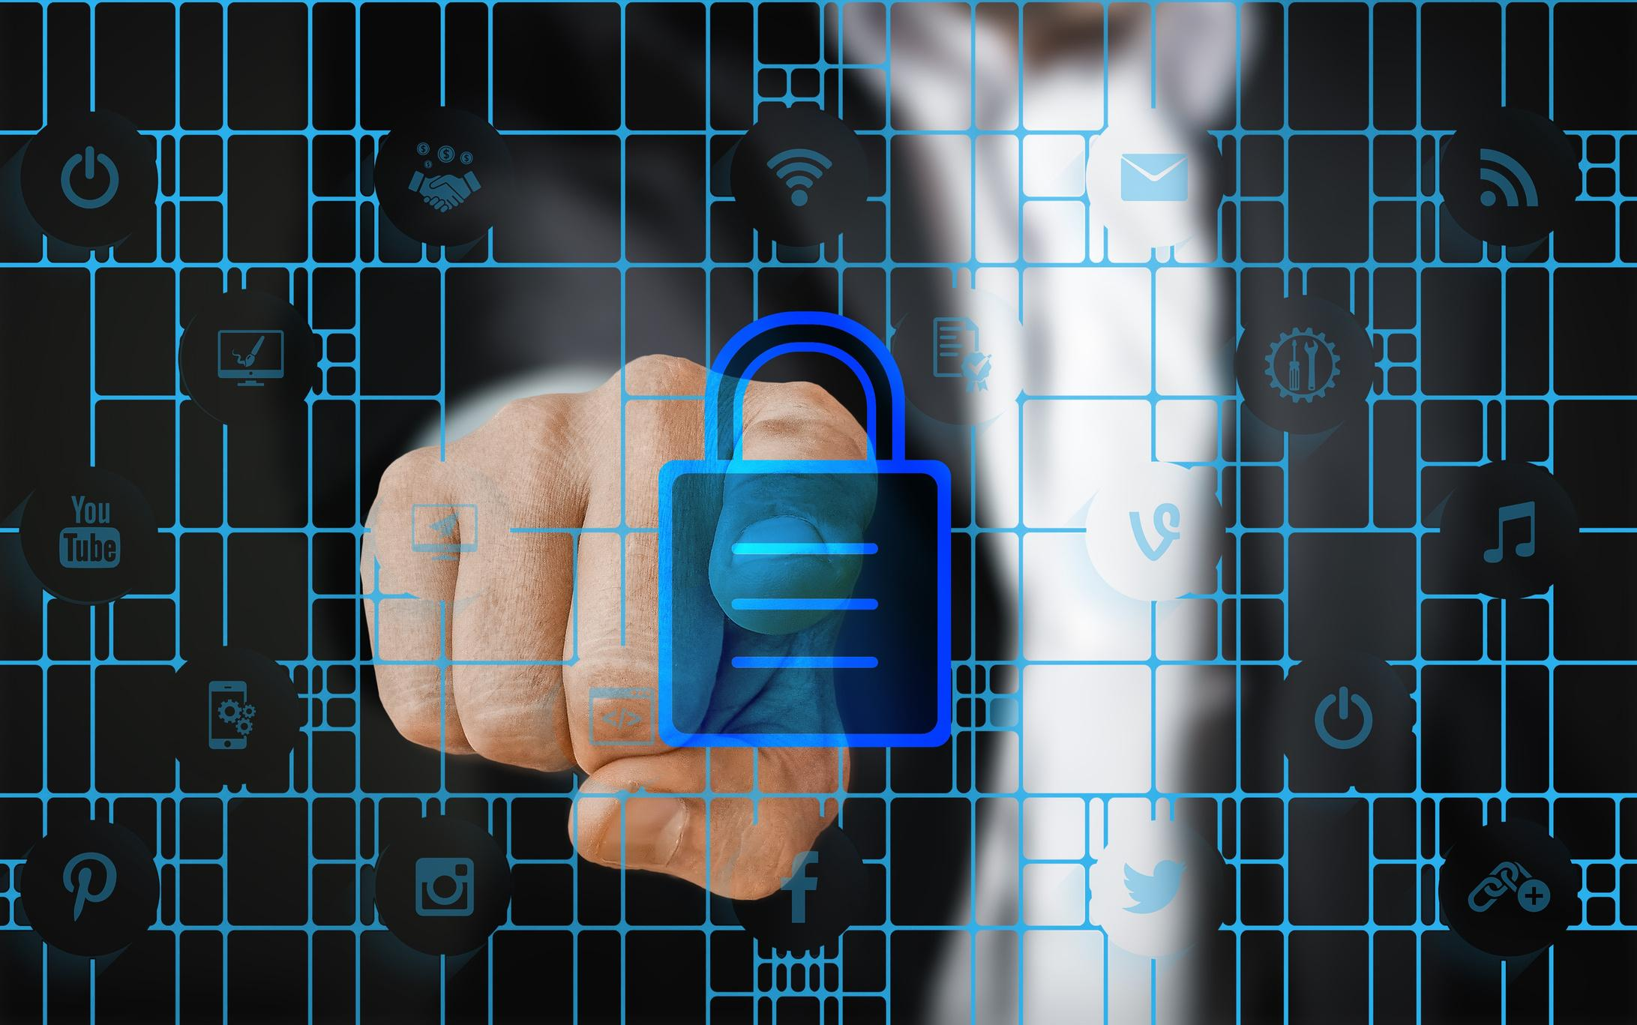





How It Works ?
Data Capture:
Feature Extraction:
Storage:
Matching:
Matching:
Collect biometric data (e.g., scan fingerprint).
Convert unique traits into a digital template.
Save securely (locally or in encrypted databases).
Compare live input with stored template.
Grant or deny access based on match score.

Slide 6

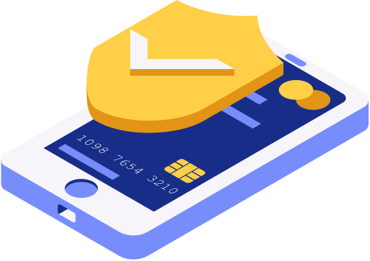
Real-Life Applications
Banking & Payments: UPI, Google Pay, Paytm use fingerprint/face for secure transactions.
Social Media Apps: Instagram & Snapchat use facial recognition for login.
Healthcare Apps: Access to patient data via biometrics.

Slide 7


Advantages
Enhanced Security: Harder to steal or duplicate.
Speed & Efficiency: Fast login and verification.
User-Friendly: No need to remember passwords.
Fraud Reduction: Minimizes identity theft.

Slide 8

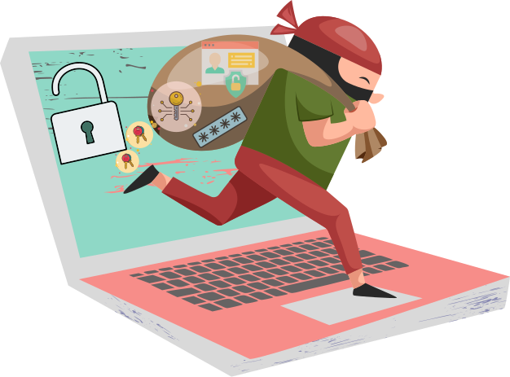
Challenges & Limitations
Privacy Concerns: Risk of misuse of biometric data.
Data Breach Risks: Once stolen, biometrics cannot be changed.
Hardware Dependency: Requires compatible sensors.
Accuracy Issues: Affected by injuries, lighting, or aging.

Slide 9

Future of Biometric Authentication
Multi-Modal Biometrics: Combining fingerprint + face for higher accuracy.
AI & Machine Learning Integration: Smarter and faster recognition.
Blockchain for Secure Storage: Decentralized biometric data management.

Slide 10


Conclusion
Biometrics have transformed how we secure and access digital services.
They strike the right balance between security and convenience.
As technology advances, biometric authentication will become the foundation of digital identity.
Quote: “Your body is your password.”

Slide 11

Thank You

